Slide 1


Installing Git in Windows

Slide 2
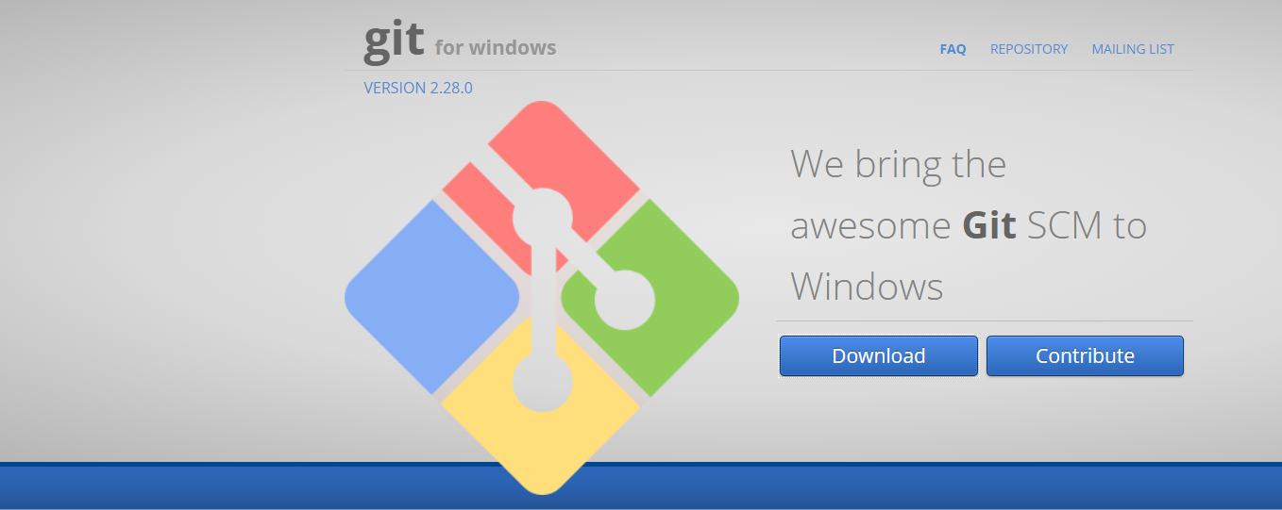

Installation
T
Go to www.gitforwindows.org and download the latest version

Slide 3
Installation
T
Since GIT comes with several options to configure, we eased you out the most convenient ones.
Make sure that in each window, you have marked the same options.

Slide 4
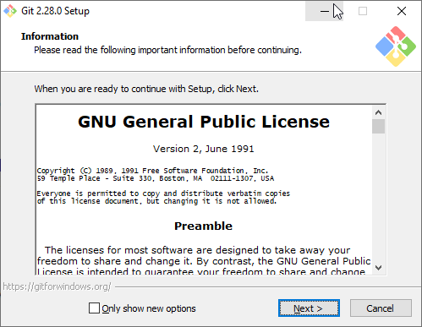
Installation
T

Slide 5
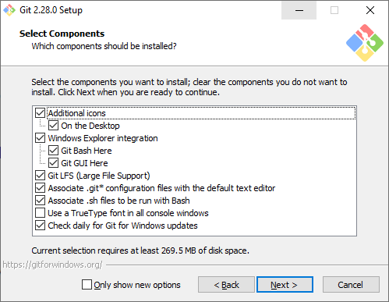
Installation
T

Slide 6
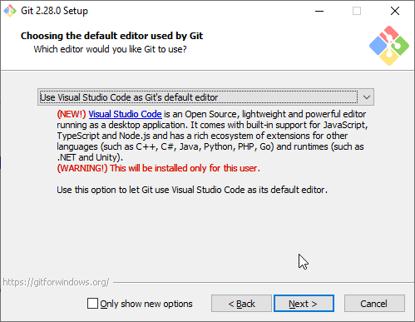
Installation
T

Slide 7
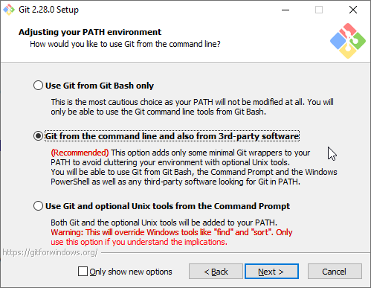
Installation
T

Slide 8
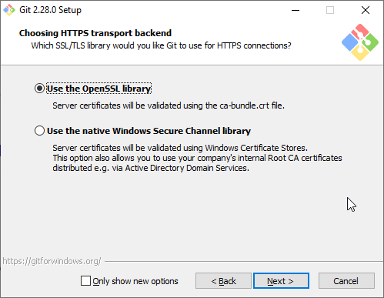
Installation
T

Slide 9
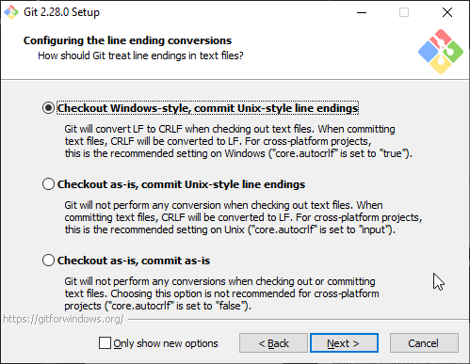
Installation
T

Slide 10
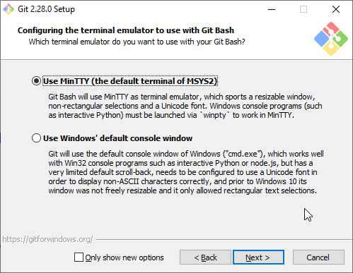
Installation
T

Slide 11
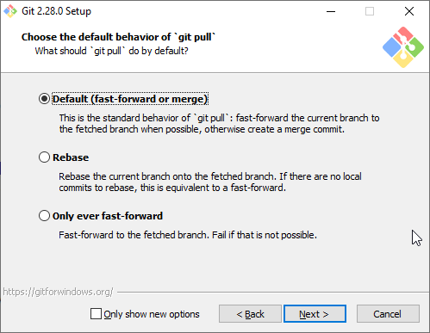
Installation
T

Slide 12
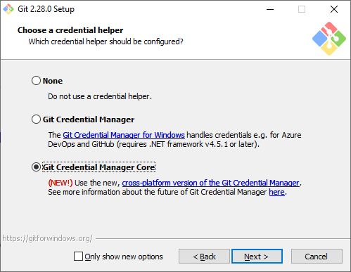
Installation
T

Slide 13
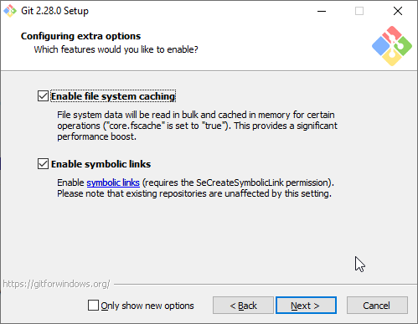
Installation
T

Slide 14
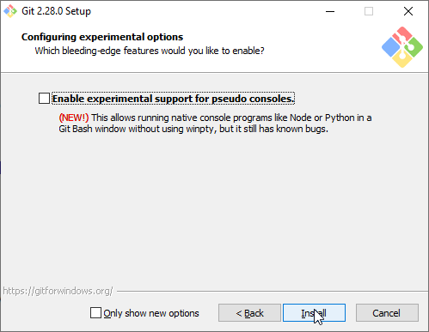
Installation
T

Slide 15
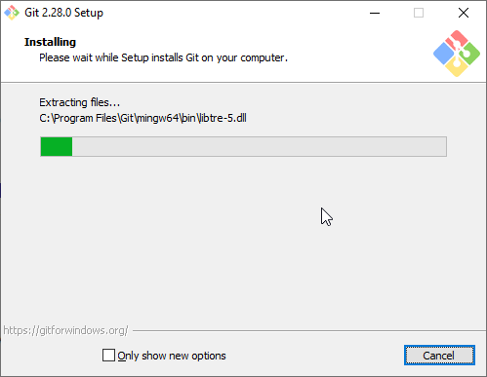
Installation
T

Slide 16
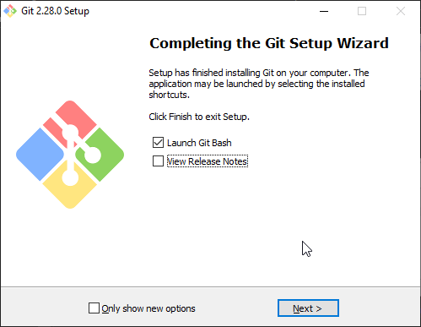
Installation
T

Slide 17
Installation
T
RESTART

Slide 18
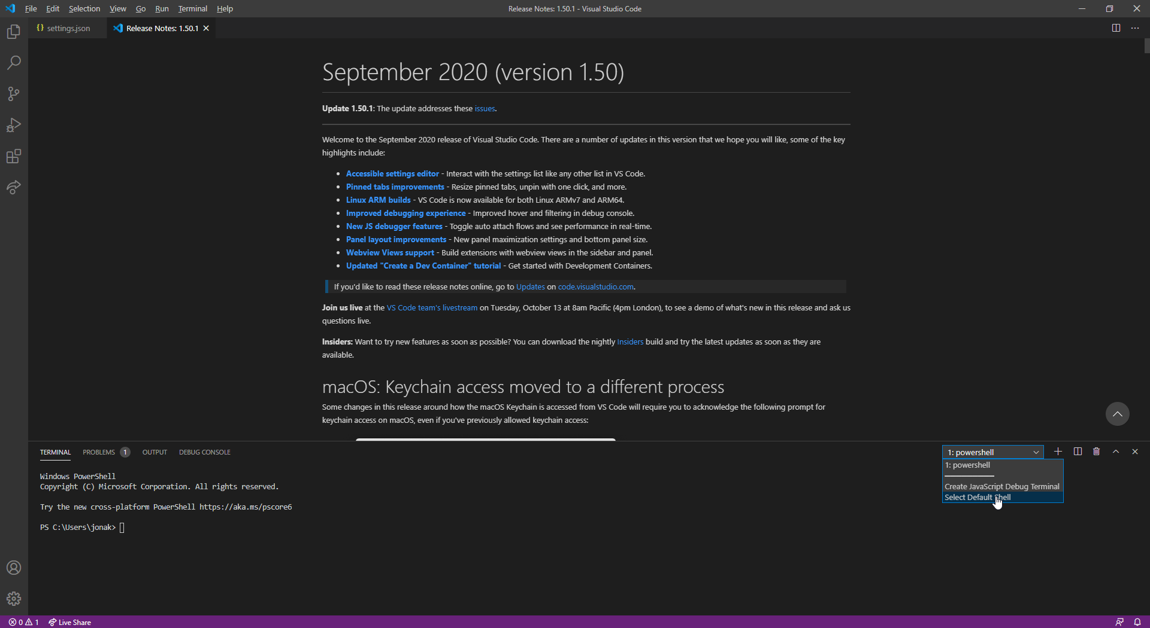
Installation
T

Slide 19
Installation
T
Now let's set also Bash as the default on Visual Studio Code.
Open the terminal (View > Terminal). From the dropdown menu on the right, choose “Select default Shell” and pick “Bash” (see next slide)

Slide 20
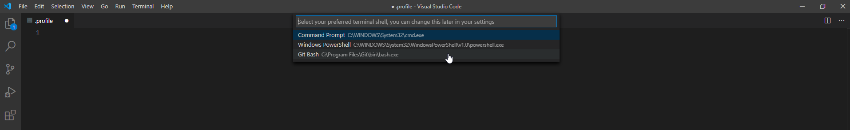
Installation
T

Slide 21
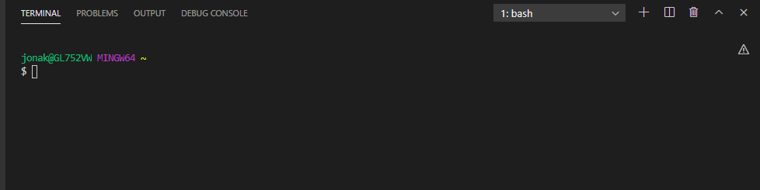
TroubleShooting
T
If for any reason, the terminal window in VSC doesn’t look like this:
You might need to configure the HOME environment variable.

Slide 22
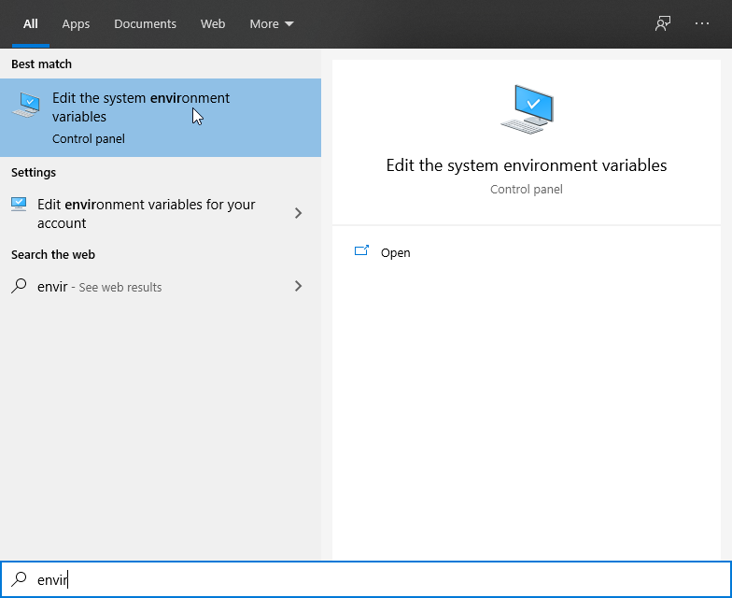
Configuring Environment Variables
Search for environment variables. Click on ‘Edit The system environment Variables’

Slide 23
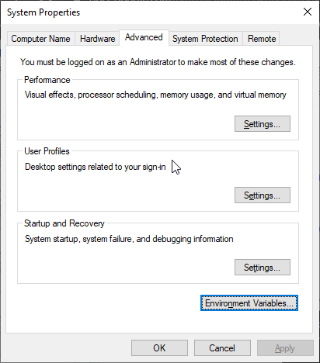
Configuring Environment Variables
Go To ‘Advanced’ and click on ‘Environment Variables’

Slide 24
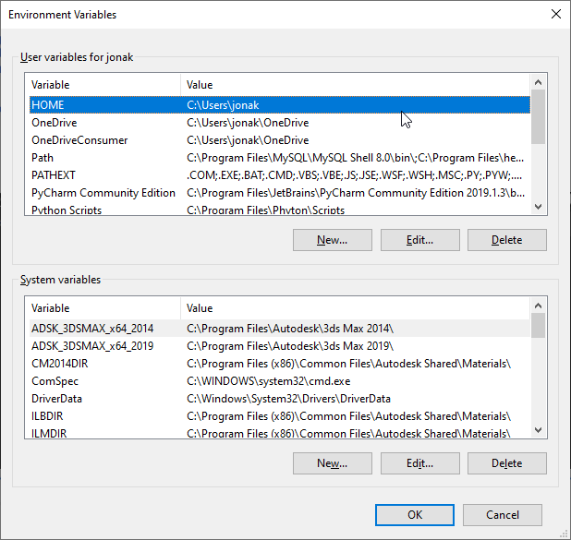
Configuring Environment Variables
Search for Home and click on Edit. You need to set it to C:\Users\<your_username>
If you don’t have a HOME environment variable, create it using the first button <New...>
Beware that it needs to be HOME and not Home or home.
Under Value, browse for your user in:
C:\users\<your_user_name>
In this case is ‘jonak’ but could be any else, even ‘user’.

Slide 25
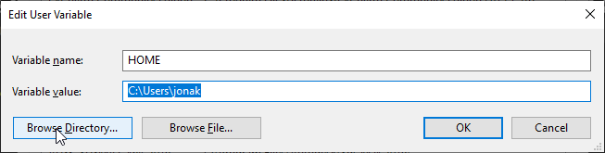
Configuring Environment Variables
Search for Home and click on Edit. You need to set it to C:\Users\<your_username>
RESTART
Now you should be able to change the default Shell in VSC.

